Slide 1
Quick guide to getting started using Postman

Slide 2
Contents
Purpose
What is Postman?
Background: What are the technologies?
Creating a request
Background: Creating a request
Creating a request for specific data
Background: Creating a request for specific data
Creating a Collection
Running the Collection
Adding and running tests

Slide 3
Purpose
This document is intended to help people with using Postman for API testing
It serves as a quick start guide and does not cover all Postman functionality and all the different ways of performing an action
It is intended for people who maybe new to or have had limited exposure to API testing
The installation is not covered in this document
The examples used here are for test.onejl.uk/syst.project4.com

Slide 4
What is Postman?
Postman is a tool used to test APIs
It is used to interact with APIs through the requests and responses which are easy to create (in Postman)
Postman can do many things however for this guide we’ll focus on:
Creating requests
Creating and running a collection
Preset/default tests

Slide 5
Background: What are the technologies?
HTTP: is an application protocol for distributed, collaborative, and hypermedia information systems. HTTP is the foundation of data communication for the World Wide Web.
HTTP Verbs: HTTP defines methods (sometimes referred to as verbs) to indicate the desired action to be performed on the identified resource. What this resource represents, whether pre-existing data or data that is generated dynamically, depends on the implementation of the server.

Slide 6
HTTP Headers: carry information such as information about the client browser, the requested page, the server and etc
HTTP Status Codes: are used to convey the results of a request, for example 200 (OK) generally means the request was carried out successfully
API: is a set of subroutine definitions, protocols, and tools for building application software. In general terms, it is a set of clearly defined methods of communication between various software components

Slide 7
REST: Representational state transfer (REST) or RESTful web services are a way of providing interoperability between computer systems on the Internet. REST-compliant Web services allow requesting systems to access and manipulate textual representations of Web resources using a uniform and predefined set of stateless operations.
RESTful API: A RESTful API is an application program interface (API) that uses HTTP requests to GET, PUT, POST and DELETE data.

Slide 8
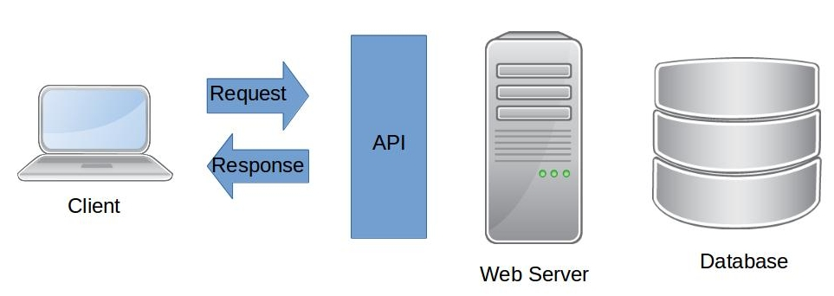
Examples:
Viewing a page -
From a browser a GET request is submitted which will hit the API and if allowed 'in' will then retrieve or ‘GET’ data from the web server/database and the data is received in the browser in the response.
Creating a account on a website -
From a browser a POST request containing details entered, such as the username, is submitted which will hit the API and if allowed 'in' will ‘POST’ data to the web server/database creating the account

Slide 9
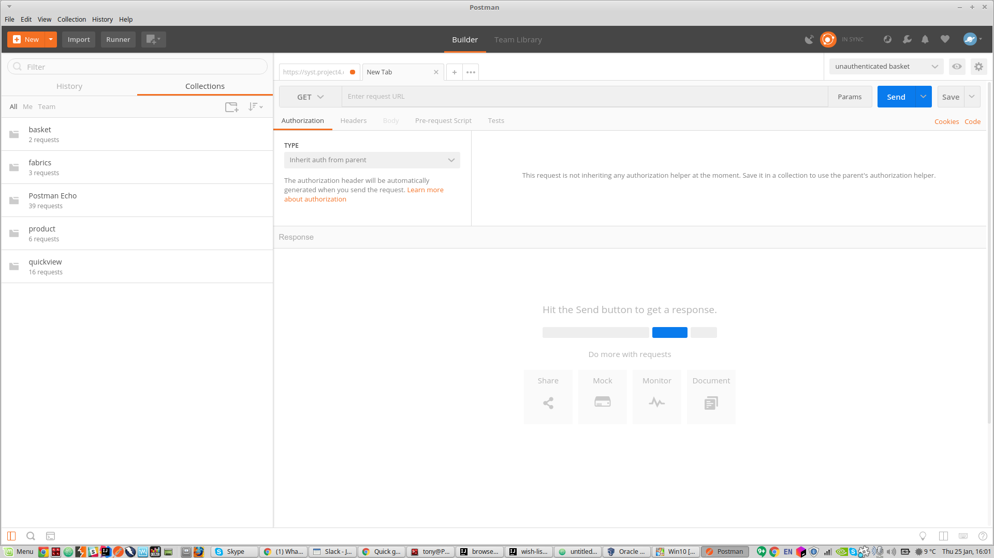
Creating a request
Launch Postman (you may receive a shortcuts modal, close it). You will receive a window similar to this

Slide 10
We are going to retrieve data so we are performing a GET request
In the ‘Enter request URL’ field enter: https://syst.project4.com/api/rest/v1/catalog/fabrics
Click Send
The response (visible in the bottom half of the window) will contain a body with all the fabrics and the data we are exposing
There will also be a status code visible, if this request was successful it should display 200 OK

Slide 11
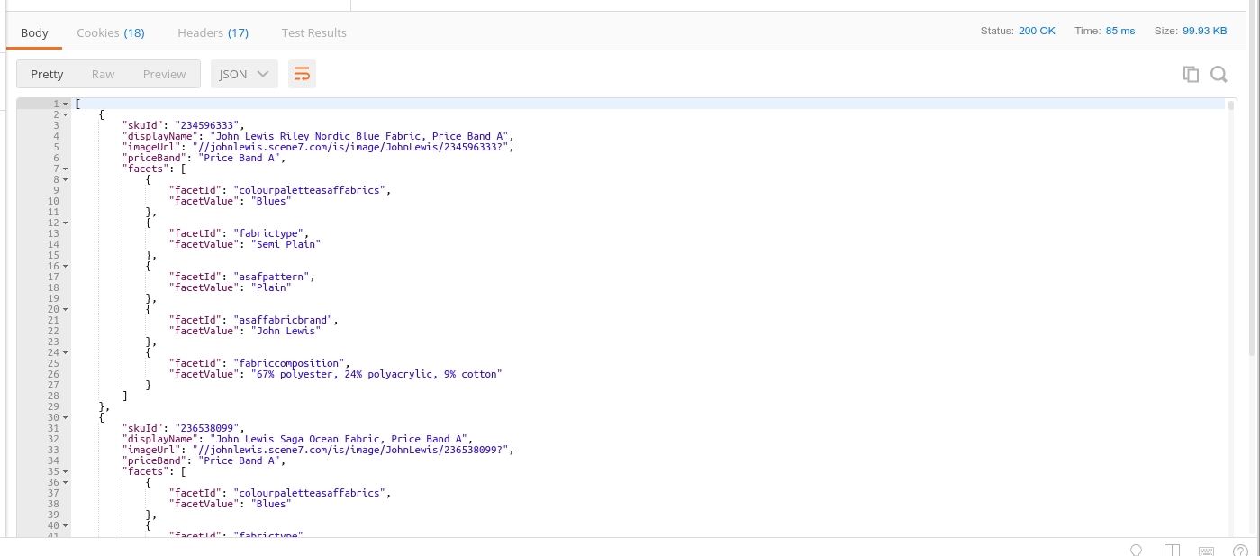
🛈 You may want to explore the Cookies and Headers to see what kind of information is there

Slide 12
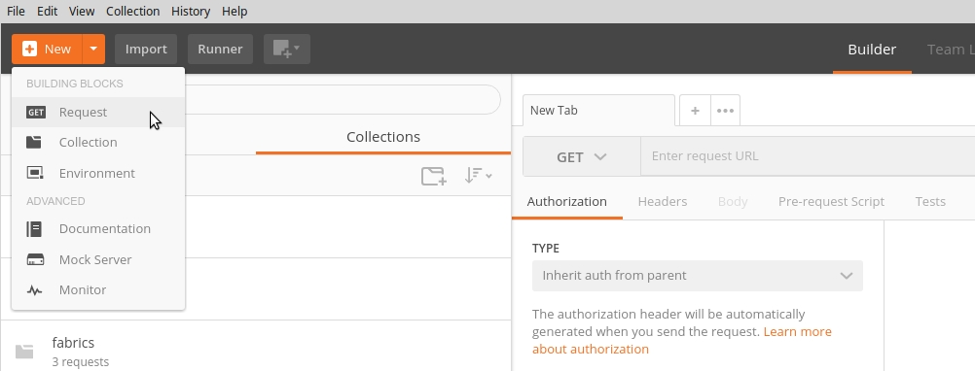
New request
Create a new request by using the New dropdown or the + symbol on the request tabs menu

Slide 13
Background: Creating a request
URL: https://syst.project4.com/api/rest/v1/catalog/fabrics
syst.project4.com = domain
api = api entry point
rest = type of api
v1 = version of api
after the version is the /path/to/resource
This is a GET request on all fabrics and will return data that has been exposed (ie what we want to share through the api) for this request

Slide 14
Creating a request for specific data
We are going to retrieve specific data by specifying query parameters in our request
In the ‘Enter request URL’ field enter: https://syst.project4.com/api/rest/v1/catalog/products?skuId=236730173
Click Send
The response (visible in the bottom half of the window) will contain a body with the details exposed for the item with skuId: 236730173
There will also be a status code visible, is this request was successful it should display 200 OK

Slide 15
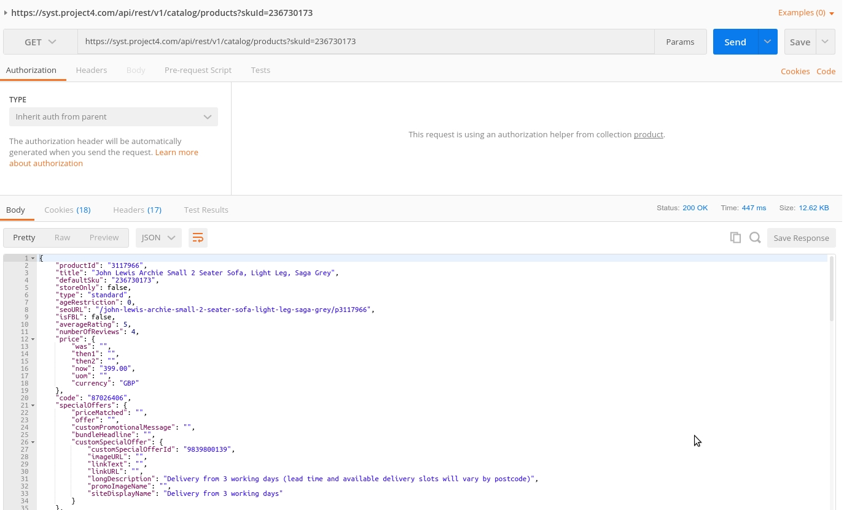

Slide 16
Background: Creating a request for specific data
URL: https://syst.project4.com/api/rest/v1/catalog/products?skuId=236730173
syst.project4.com = domain
api = api entry point
rest = type of api
v1 = version of api
after the version is the /path/to/resource
? = query
skuId=236730173 = filter skuId for 236730173
This is a GET request on skuId: 236730173 and will return the data that has been exposed (ie what we want to share through the api) for these requests

Slide 17
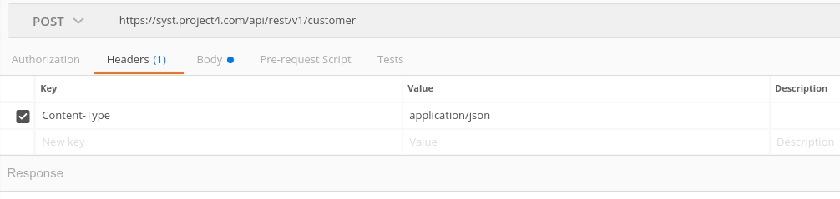
Creating test data - user account
We are going to use a POST request to create a user account
In the ‘Enter request URL’ field enter: https://syst.project4.com/api/rest/v1/customer
Change the verb to POST
Select the Headers tab
Enter in a Key of: Content-Type
Enter in a Value of: application/json

Slide 18
Click on the Body tab
Enter in the following with the details required:
{
"email": "test email address",
"password": "test password",
"confirmPassword": "test password",
"jlOptIn": false
}
Click Send
You should now be able to log in with these details

Slide 19
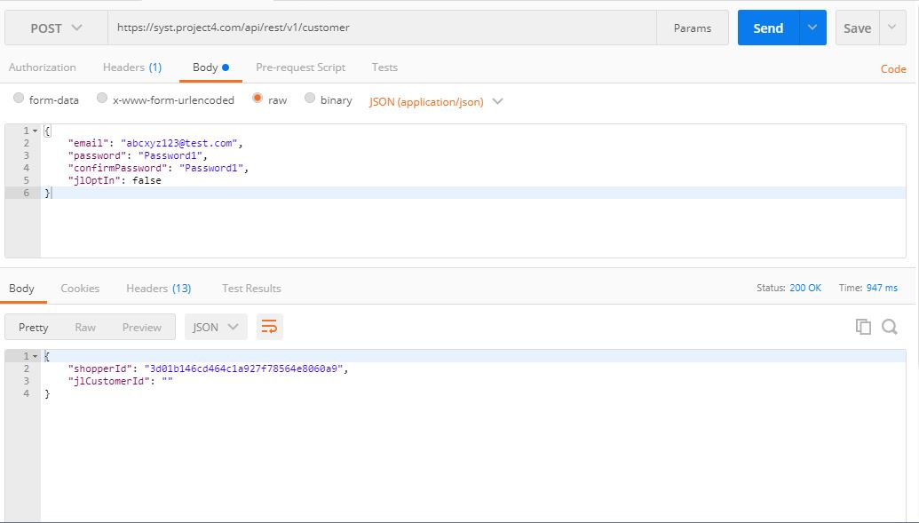

Slide 20
Collection
There are a few ways to create a Collection, we’ll use the history of requests
View the history pane in Postman
Hover over the last request and you should see some options
Click the + to display the save request modal
You will have the options to:
name the request
give the request a description
create the collection/folder
Do all three

Slide 21
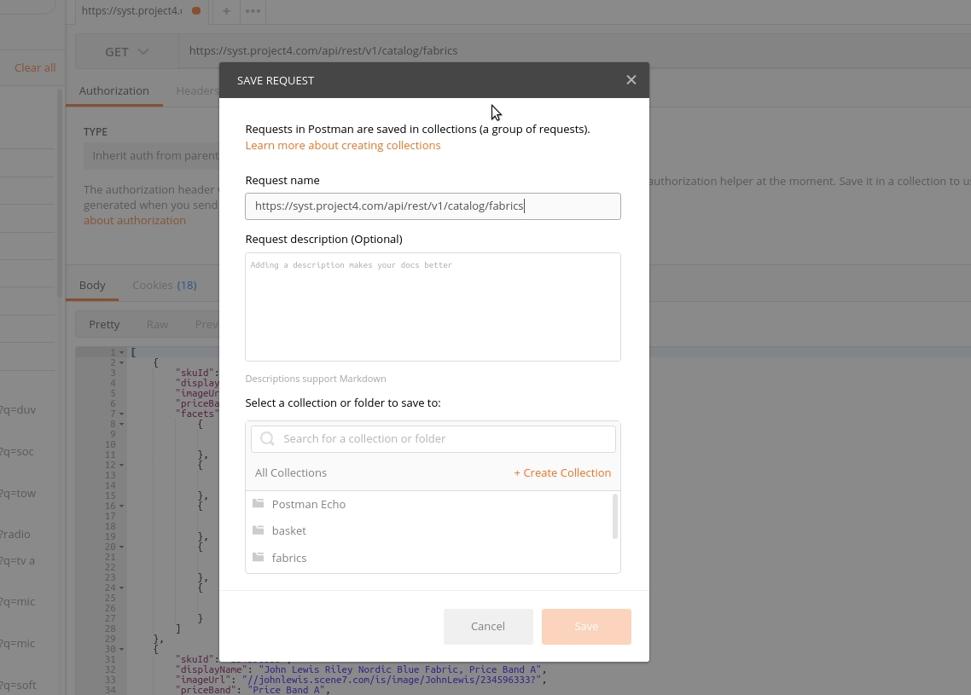

Slide 22
You will now have a folder under Collections
You can run the Collection by launching the Collection Runner via the Runner button on the top left
Select your folder
Run [folder name]
You will see a summary of the result
At this point we haven’t set Postman to assert against anything so there are neither pass or fail results
The request has just run, we haven’t checked anything

Slide 23
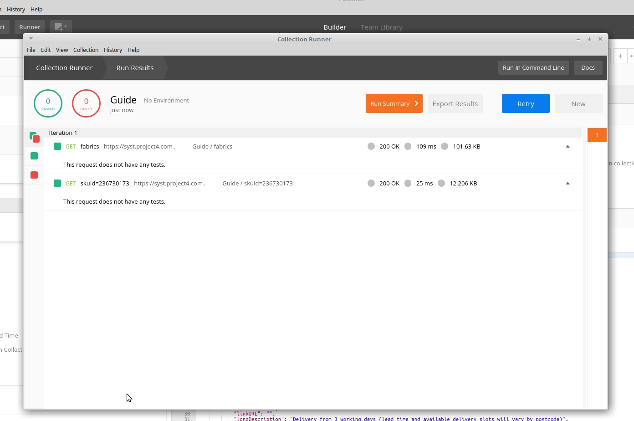

Slide 24
Adding and running tests
Tests in Postman are written in Javascript and Postman comes with a set of tests which you can use straight away
View the tests by accessing the tests panel; In the main Postman window, under the URL field you’ll see a few headings of which ‘Tests’ is one
Once you are in there the Tests should be visible on the right under the SNIPPETS heading

Slide 25
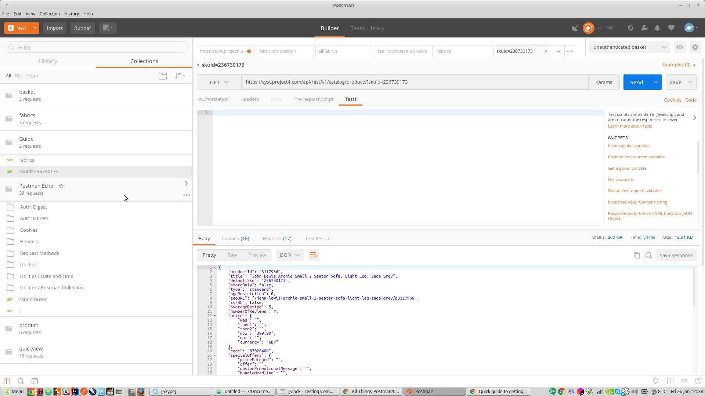

Slide 26
Let’s try the assert for status code 200 (OK) check
Scroll through the Test Snippets and select
Exactly as the snippet reads this is asserting that the response has a status of 200 (OK)
Send your request
You should now have some Test Results which are visible on the bottom of the window under the Test Results tab
🛈 You may want to explore the other tests to see what they are asserting on think about what tests you want to create/edit

Slide 27
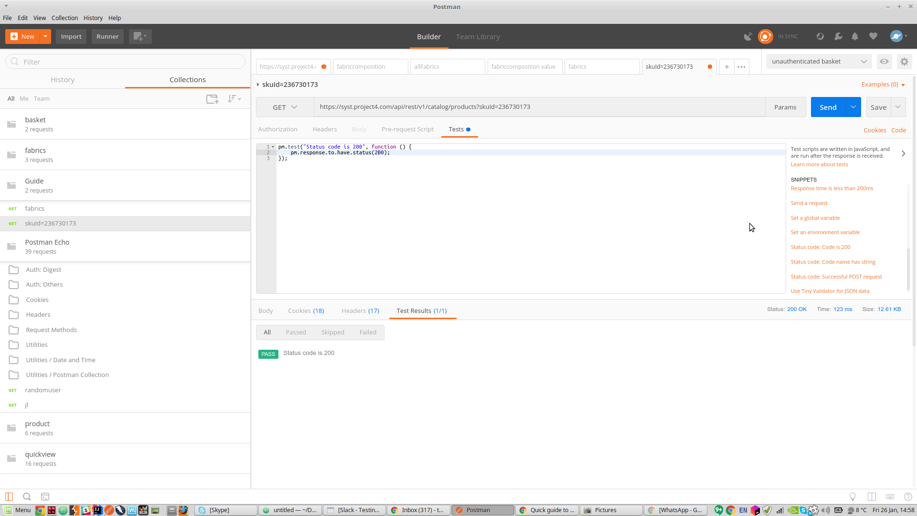

Slide 28
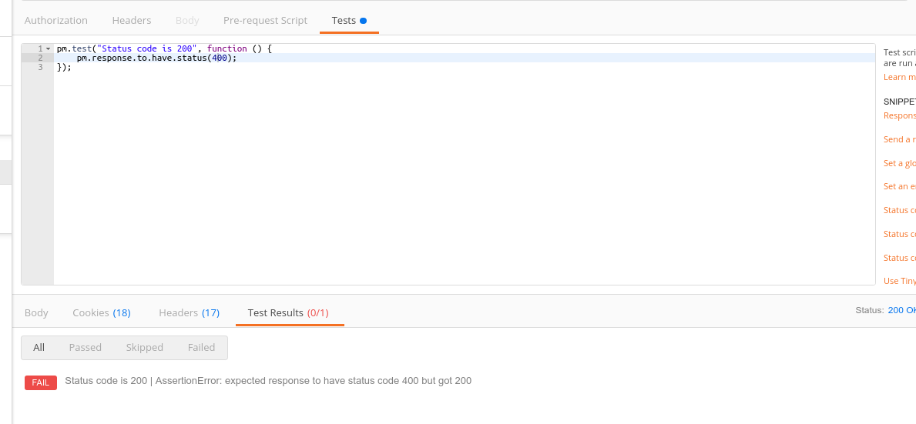
Just to see what a fail looks like let’s change the status code to 400 and send the request
Once you’ve done that don’t forget to change it back to 200

Slide 29
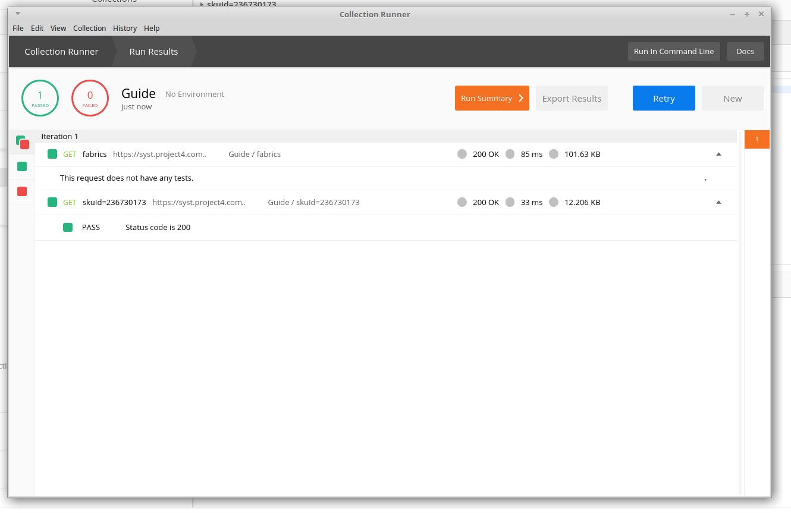
Save the request then run the Collection

Slide 30
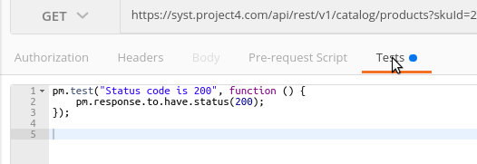
Adding another test
Let’s add another test to one of the requests
We’ll also change it slightly
In the main Postman window
Under Collections, select the request for the query on skuId=236730173
Select the Tests tab

Slide 31
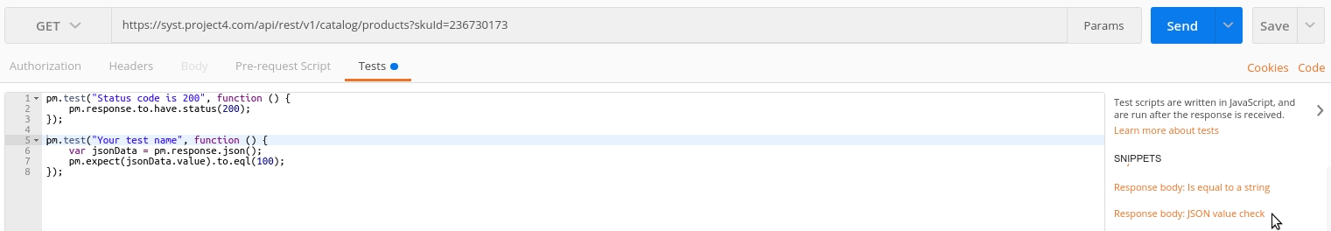
On the right, browse through the Snippets
Find “Response body: JSON value check”

Slide 32
Bibliography
http://searchmicroservices.techtarget.com/definition/RESTful-API
https://en.wikipedia.org/wiki/Representational_state_transfer
https://en.wikipedia.org/wiki/Hypertext_Transfer_Protocol

Slide 33
Further training/reading.
Learn REST: “is dedicated to tracking REST API best practices and making resources available to enable quick reference and self education for the development crafts-person”
Automating and Testing a REST API: “A Case Study in API testing using: Java, REST Assured, Postman, Tracks, cURL and HTTP Proxies”
All Things Postman: “My goal is to create a space where I can show examples of some of the many features in the tool and for it to also be a living piece of documentation, that will change over time to reflect the new changes being released”
Postman Documentation

